Slide 1
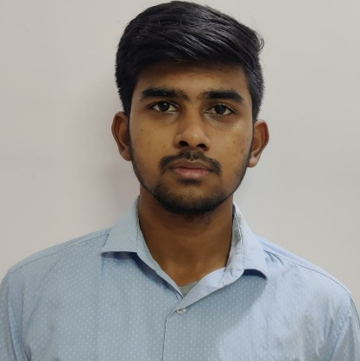


S Santosh Kumar
Analyst / Software Engineer
Bachelor of Engineering, Computer Science Engineering : 2016 - 2020
Skills
Java 8 /J2EE | Java Basics, OOPS, Generics, Collections, Arrays, Loops, Lambda Exp, Servlets
C# | C# Basics, OOPS, Generics, Collections, Array, Loops, LINQ
.NET | ADO.NET,ASP.NET with MVC5 and WEB API,Entity Framework
Database | MS SQL Server
UI Tech | HTML 5 & CSS 3,JavaScript, ES6
Tools | Git
Add On skills | Team Management and Communication skills.
Bangalore
santosh-kumar.s@capgemini.com
+91 8754874836
A4
Full Stack Developer
Hands on experience on C#,ADO.NET ,LINQ, Entity Framework, SQL Server.
Proficient in creating Single page Web Application in React.
Hands on experience in developing web pages using HTML5, CSS3, Object Oriented Java script, TypeScript, ES6, JSON, XML. Good understanding of Document Object Model (DOM) and DOM Functions.
Certified with Microsoft Azure Fundamentals​ and Azure Administrator.
Completed case study on Pharmacy Management System which is used to manage the drugs as well as supplier details and user can also login and order drugs whereas admin will verify that order.
https://github.com/Santosh1905

